Slide 1

Drawing on Complexity to do Hands-on Evaluation
Jonathan A. Morell, PhD
Email: jamorell@jamorell.com
Web: www.jamorell.com
Blog: Surprises in Programs and their Evaluations*
Canadian Evaluation Society – Nova Scotia
Professional Development
June 3rd 2016
Should evaluation recognize “complexity” when program design does not?
What does complexity say about
  “stability” and “predictability”
  “instability” and “unpredictability”?
Why do things change?
Where does change come from?
When is change sudden or gradual?
What patterns can program outcomes have?
Do we really need to invoke complexity?
* https://evaluationuncertainty.com/

Slide 2
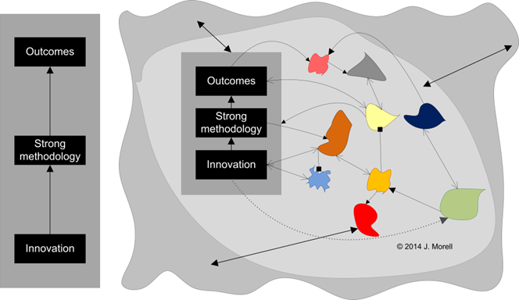
Why should we care about complexity?
We are discontented
As citizens, our programs do not adequately improve the social condition
As evaluators, our program theories and methodologies disappoint in explaining and predicting program behavior
Because
We think we are evaluating this
When we are actually evaluating this.
Small changes bring about big changes
Big changes can have small consequences
Unintended positive and negative outcomes
Programs that work on a small scale but do not scale up
Best practices that do not hold up from setting to setting
Small changes cascade through systems in unpredictable ways
Programs that do not change no matter how hard we hit them over the head with data

Slide 3
Let’s get to know each other
Who are you?
What is your name?
Where do you work?
What is an interesting project you have worked on?
Tell us anything about your interest in complexity
  What do you think it is?
  Why are you interested in it?
  Why are you confused about it?
  Something you think is complex
  Name of a book or article you read
  Something someone told you about it
  A project you are working on that you think is complex
Expectations
Mine
  You will know how to apply some complexity ideas to the evaluation you do
  You will have lots of practice
Yours?

Slide 4
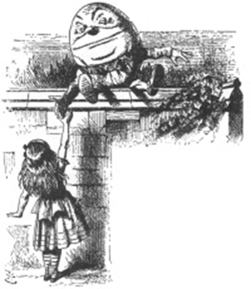
Definitions
What is complexity?
Complex system
Anything with lots of feedback loops
A lot of things connected to lots of other things
Whatever seems too complicated for us to understand
Anything with sensitive dependence on initial conditions
Behavior that emerges without planning from other activity
Wicked problem, everything is connected to everything else, so nothing seems stable, predictable or reliable
Anything else you have ever heard?
Which definition is right?
'When I use a word,' Humpty Dumpty said, in rather a scornful tone, 'it means just what I choose it to mean — neither more nor less.'
'The question is,' said Alice, 'whether you can make words mean so many different things.'
'The question is,' said Humpty Dumpty, 'which is to be master — that's all.'

Slide 5
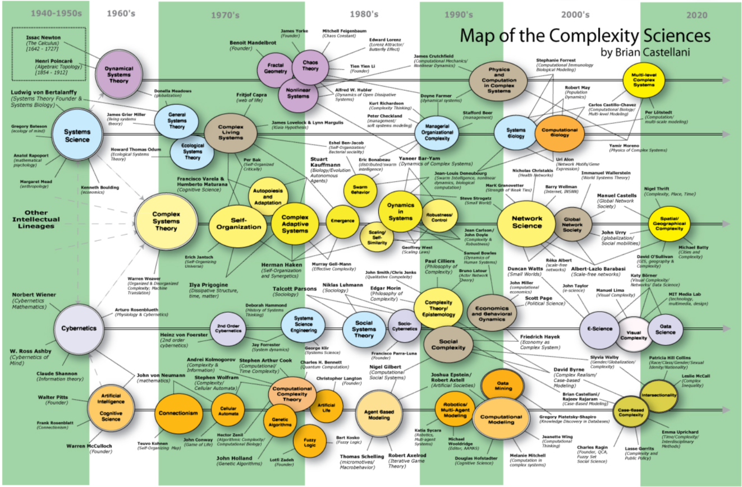
“Complexity” has a very long, rich intellectual history. This workshop will pick only a few concepts that I think are useful for doing hands-on evaluation
http://www.art-sciencefactory.com/complexity-map_feb09.html

Slide 6
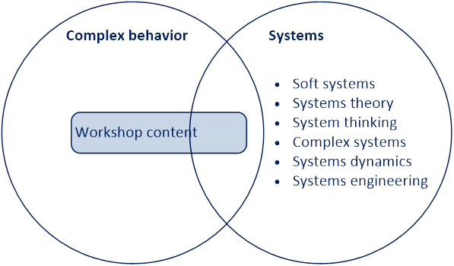
Complex behavior and systems

Slide 7
A pitch for taking complexity science seriously in evaluation
Two legitimate modes of drawing on complexity
Instrumentally
Inspiration and insight
How much can we distort what is known about complexity?
Science cares about what is true
Technologists care about what works
We are technologists
If invoking complexity in any way, shape, or form leads to doing good evaluation, I’m in favor of it.
Science begins to matter when technology stops working
We are skirting that limit with some concepts that are proving very useful in evaluation
My favorite examples
  Agreement x certainty
  Simple, complicated, complex

Slide 8
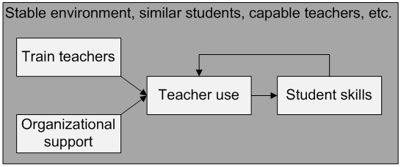
Reasons to take complexity science seriously one (of many) examples: Simple, complicated, complex
Seemingly “simple” systems can behave in unpredictable ways
Even one puny feedback loop can cause such behavior
If I thought this system was simple, I might not
Try to evaluate sudden or non-linear behavior
Carefully assess the schools’ monitoring and reaction to that feedback loop
Assume that sudden unexpected behavior resulted from internal program operations

Slide 9
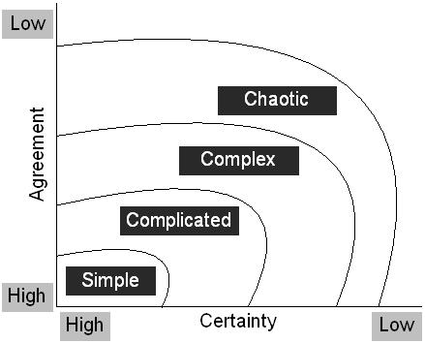
Reasons to take complexity science seriously: A second (of many) examples
Agreement x certainty
A
A “simple” system can be chaotic
B
Here can be excruciatingly stable
Legislation or regulation holds it in place
Nobody knows how to do anything better
Any alternate solutions are prohibitively expensive
Everybody is doing as well as they can without decreasing the satisfaction of others
B
A
If I thought that B was unstable, I would not
Include stability in my program theory
Implement an evaluation design to understand why the program is stable

Slide 10
Explaining complexity
Complexity stuff is odd
Does not fit with familiar assumptions that underlie our quantitative and qualitative methodologies
Work with me if you get confused
Coherent explanation of statistical reasoning is easy
Mean
Variance
Null hypothesis
Type 1, type 2 error
Uncorrelated true score and error
Error normally distributed. Mean = 0
Representative sampling and sample size
But “complexity” is not coherent
Roots in many fields, e.g. biology, meteorology, physics, math, geography, etc.
Some cross-field borrowing, some reinvention
Complexity researchers are those who self-identify as complexity researchers
There are statisticians but there are no “complexisists”

Slide 11
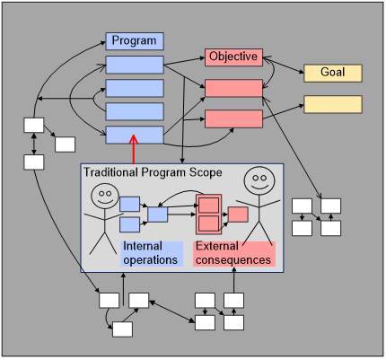
Complexity in program design and evaluation
It can make a lot of sense for program designers to not acknowledge complexity
Can those people coordinate across boundaries?
Even if they did, desired outcomes not occur
  Different stakeholders
  Stovepipes are efficient
  Multiple priorities in each part
  Different organizational cultures
  Few personal working relationships
  Unknown, unknowable interactions
  Cost of coordination people, $, time
  Different schedules for decision making
Advocate with planners but do not insist
Appreciate why a systems approach is uncommon
Do evaluation that recognizes complexity
Produce knowledge that program designers can use
How should evaluators engage complexity?

Slide 12
Here are some complexity concepts that can be useful in evaluation
Attractors | What they are
 | Use in Evaluation
Strange attractors | What they are
 | Use in Evaluation
Power laws | What they are
 | Why they occur
 | Use in Evaluation
Where does change come from? | External
 | Internal Use in evaluation
How fast does change happen? | Incremental
 | Sudden Use in evaluation
Why does sudden change happen? | Rich get richer
 | Joint optimization Use in evaluation
Emergent change | Bees
 | Human scale
 | Use in evaluation outside of computer simulation
Wrap up | Disclaimer / summary
 | Resources

Slide 13

Attractors
Different way of thinking about stability and predictability
Useful metaphors
Attractors
Strange attractors
If anything, our programs are too stable, not too unstable
Beat them over the head with data and they don’t change
Why is it useful?
Program theory that captures historical trends
Conceptualize change in terms of shape and stability
Parsimonious way to classify a whole variety of settings.
Insight about program behavior outside of stakeholder beliefs
Promotes technological perspective: What will happen, not why
Hint where to look for similar programs when designing evaluation
Plan for this section
Attractors in complexity
Strange attractors in complexity
Examples of applications in evaluation

Slide 14
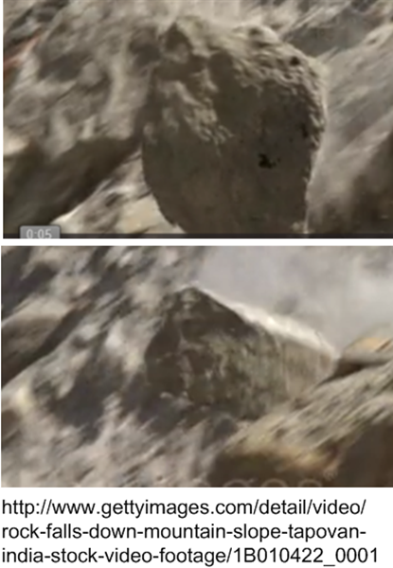
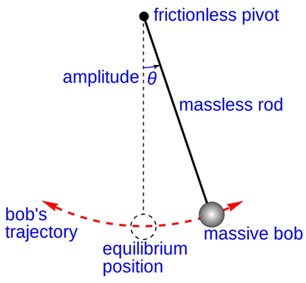

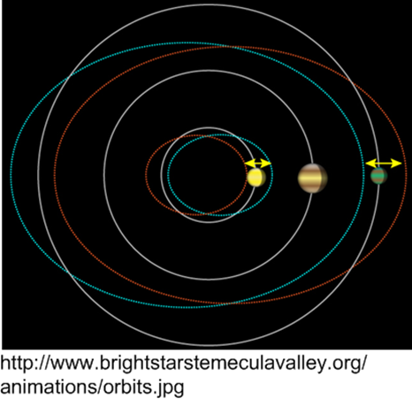

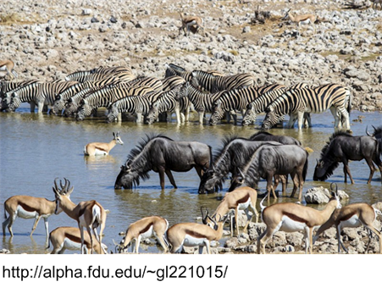
What are attractors?
Values close enough remain close if slightly disturbed
Properties toward which a system evolves, regardless of starting conditions
http://www.watershedconnect.com
http://barronberry.com/firm-news-and-events/celebrate-national-playground-safety-week-keep-your-kids-safe/

Slide 15
How can I use attractors in evaluation?
Stakeholders
Insight outside of stakeholder views, e.g. How will the program evolve? What kind of staff will join? What outcomes may result?
Program types
Parsimonious way to classify a range of settings. Programs with different missions and service recipients may behave the same way.
Program theory
Based on on historical trends. What happens to programs that “look like” this?
Evaluation design
Look for similar programs for design inspiration. E.g. Any program that allocates scarce resources will draw criticism from non-participants. Need to evaluate criticism and its consequences
Novel way to think about program change and outcome
Shape, stability, change trajectory

Slide 16
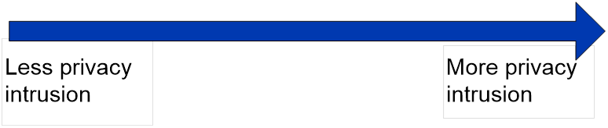
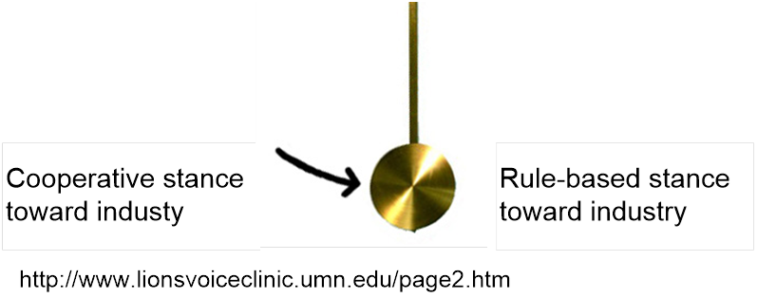
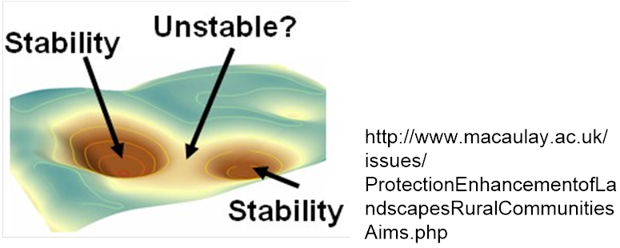
Some examples of using attractors as program theory
Any/all agencies involved in anti-terrorism surveillance
Implications for long term effectiveness of a program to protect privacy?
Any/all Federal regulatory agencies
Implications for a program to improve joint agency / industry root cause problem solving?
Most of what we do
Implications for discerning outcomes and needed program strength

Slide 17

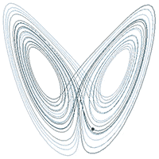
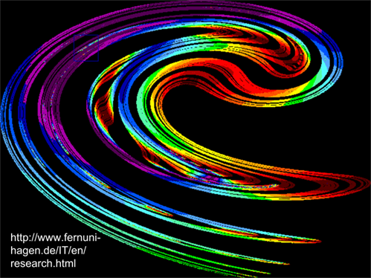

Strange attractors
Impossible to know location from one instant to the next
Know where it will not be
Bounded chaotic movement
Fractal
Useful metaphor for an evaluator
Scale up
Replication
Transfer to other settings
Realistic program theory
Stakeholder expectations
Identify program outcomes
Methodology to touch range of outcomes

Slide 18
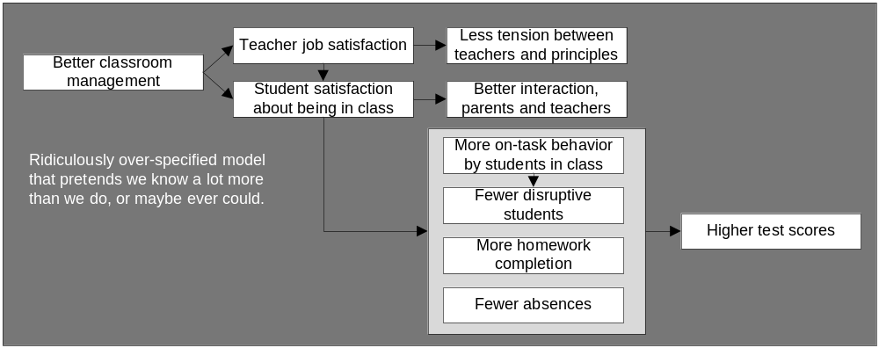
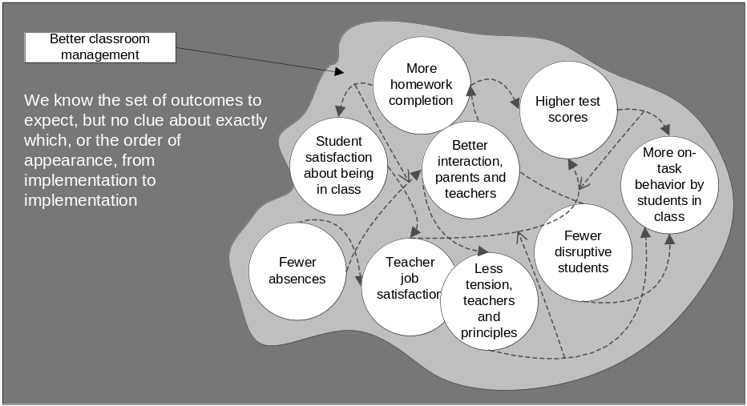
Example – strange attractors in program theory: Help teachers do better classroom management
We can identify universe of outcomes
Fewer absences
Higher test scores
Higher student satisfaction
More homework completion
Higher teacher job satisfaction
More on-task behavior by student
Better interaction, teachers & parents
Less tension between teachers & principals
But can we identify which ones will happen when?
Sensitive dependence among outcomes
Any small change in the configuration may set events on a different path
Decent level of predictability. We know
what will happen, but not the order in each implementation. Implications for
Methodology
Policy making
Program theory
Estimating impact

Slide 19
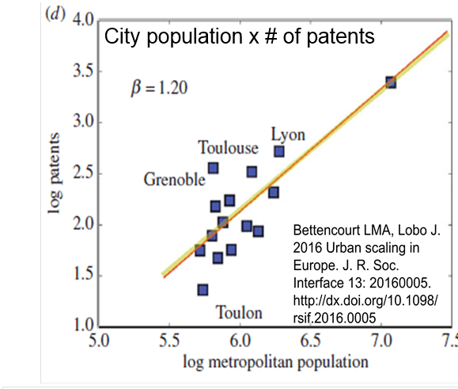
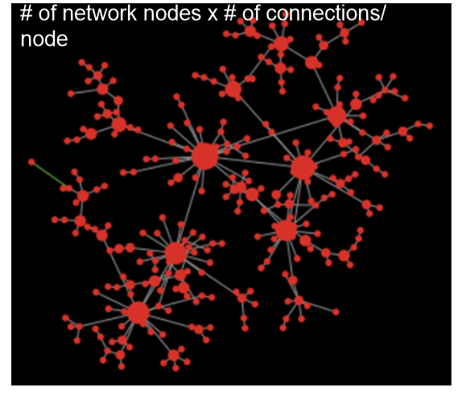
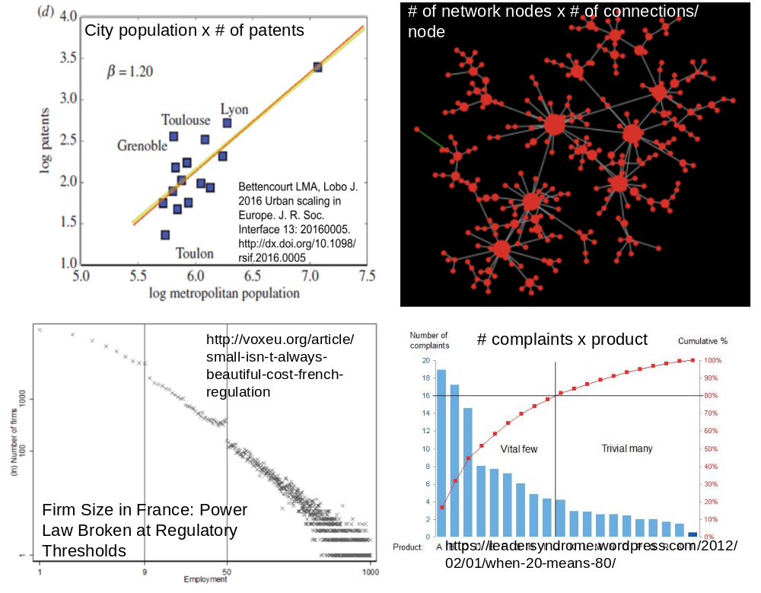
Complexity shows that many outcomes may have power law (or at least long tailed) distributions

Slide 20
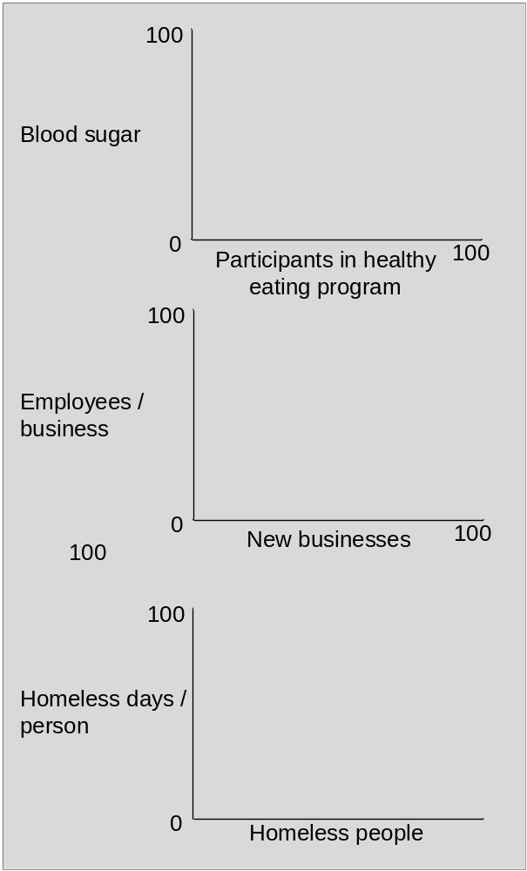
Asymmetrical outcomes in evaluation: Discerning pattern
How might these program outcomes be distributed?
What could I see myself evaluating with outcomes distributed like this?
Diabetics in health eating program
# of people who spend # of homeless days
Small businesses success
Methodology:
Choice of case studies
Statistical / analytical methods
Sample size changes with non-normality
Special effort to determine collective impact of many small improvements
Stakeholders:
Benefit not spread evenly
Cost per success very high
Long term impacts take on added importance

Slide 21
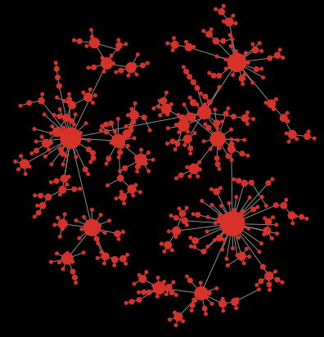
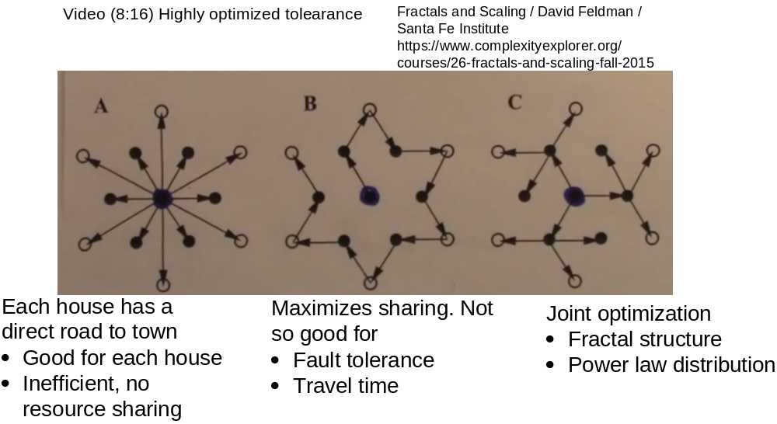
Asymmetrical outcomes in evaluation: Explaining pattern
Size attracts
Rich get richer
Appeal of popularity
Likelihood of contact
Random fluctuation builds on itself
Optimum seeking
Jointly optimizing negatively correlated variables often yields power law distributions

Slide 22
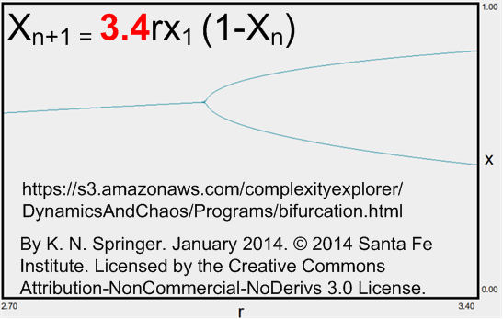
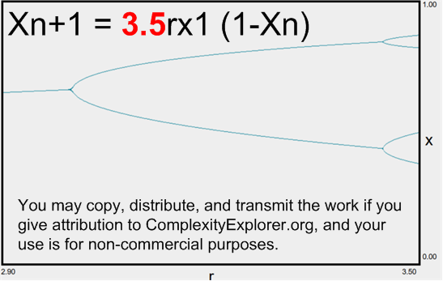
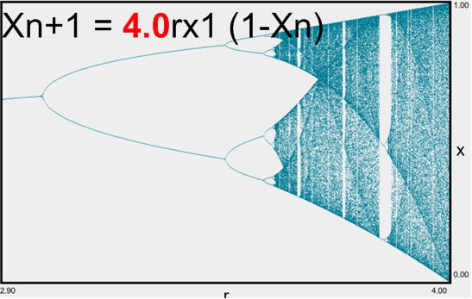
Where does change come from?
Perturbations from outside
But also
Insight from complexity: change can be only for internal reasons
Program theory
Cannot assume we put all the feedback loops in our program theory
Feedback loop activity may explain
  Outcomes (intended and unintended)
  Success/failure of replication and scale-up
Methodology
Frequent contact
Knowledgeable monitoring
Open ended query capability (quantitative and qualitative)
Stakeholders
Good guidance requires ability to tell them whether unexpected behavior results from
  environmental change, or
  normal program operations

Slide 23
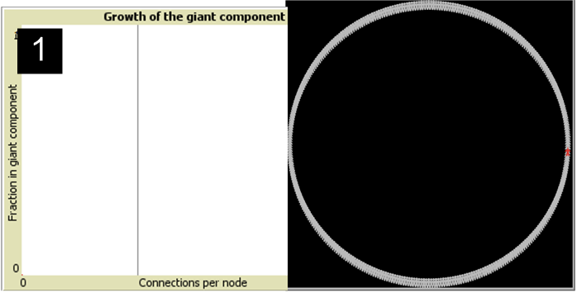
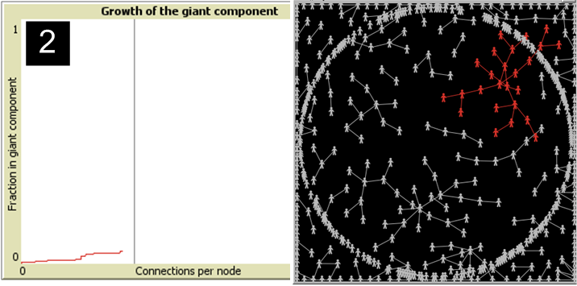
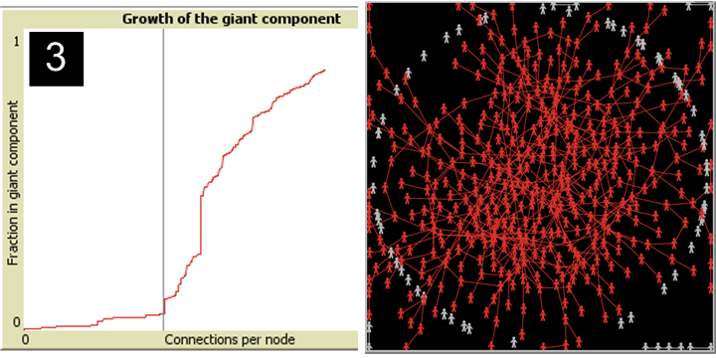
An insight from complexity is that change can happen quickly
Size of largest network cluster when nodes are randomly connected
Start
Minimal change for along time
Rapid change

Slide 24
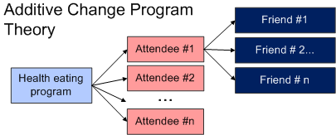
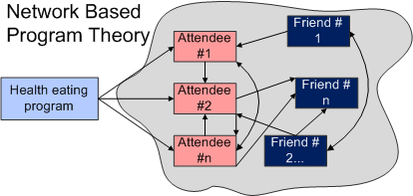
Evaluation example: Program to teach healthy eating in a community
Program theory I would use (and I bet you would too)
More people + more education = higher program impact
Participants teach others = a nice bonus
Alternate theory in network terms
Each time a person learns something, he or she imparts knowledge to someone else regardless of whether person in the program
As people practice, they learn something new
The total pool of knowledge increases
The more knowledge about healthy eating, the greater the incentive to educate others
Looks suspiciously like the network example
Implications for evaluation
Expect small change over a long period of time
“Incremental success” no longer a desirable outcome
Interviews, observation to discern networking process
Desirability of measuring more than curriculum knowledge
Frequent measurement to test network program theory and ID inflection point

Slide 25
Complexity provides a different perspective on why things change
Emergence
An alternate view of change
An important insight from complexity
Makes us think about program theory in a different way
Maybe the most interesting topic today
Certainly the most useless in practical terms
How do we do things now?
Specify relationships 1:1, 1:many, many:1, and many:many
Assume that individual units of analysis do not matter
Assume that with good methodology we can measure the relationships.
We bow at the alter of the general linear model y = Xβ + e
With good sampling and measurement, we can trust our statistics
We do everything we can to get good estimates of means and variances
This is one of the greatest intellectual triumphs since the Enlightenment

Slide 26
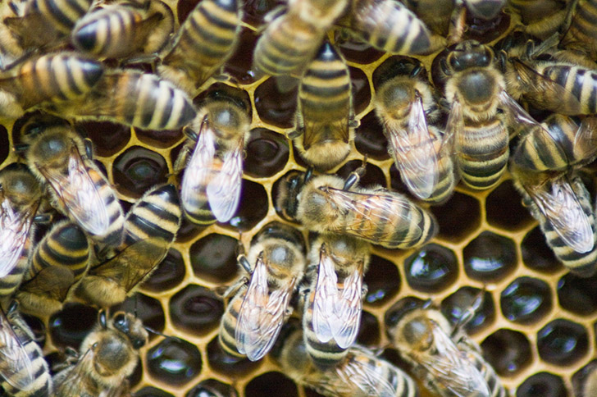
Emergence provides a different view of causation
Arising of novel and coherent structures, patterns and properties during the process of self-organization in complex systems wikipedia.org/wiki/Emergence
Beehives are a good example
Bees are stupid
No central beehive plan
Bees only follow a few simple rules
With collective action you get beehives
Emergence cannot be explained in terms of means and variances

Slide 27
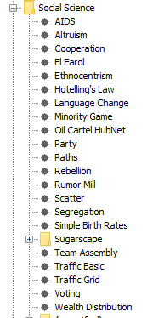
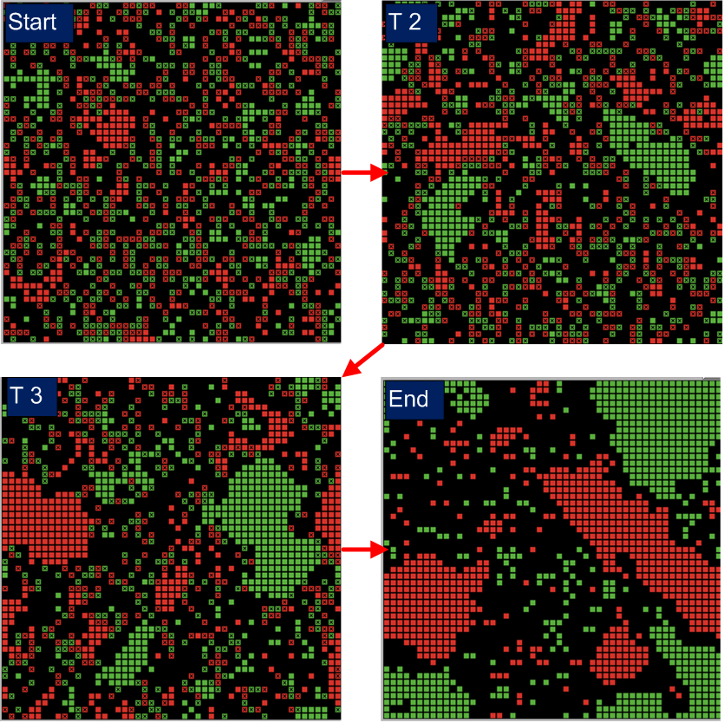
What about the kinds of things we evaluate?
People?
Classrooms?
Health clinics?
County governments?
Emergence has been shown in a very wide range of human and social behavior.
See Net Logo library for many juicy examples
Here is one of those examples
Drop families into cyber world
If 2 or more neighbors are your color, stay
Otherwise, move
No other factors, e.g. bank lending, friendships, real estate values
Neighborhood segregates

Slide 28
Some practical uses
Outside of computer simulation, how can we use this?
Humility. It builds character to believe that programs might work in a radically different ways
Consider agents when developing program theory
E.g. in an educational innovation, who are the agents?
  Students?
  Teachers?
  Classrooms?
  Whole schools?
  Would lead to some worthwhile questions. E.g.
    What are the ways a classroom can change?
    If it changed, what are the reactions that other classrooms have?

Slide 29
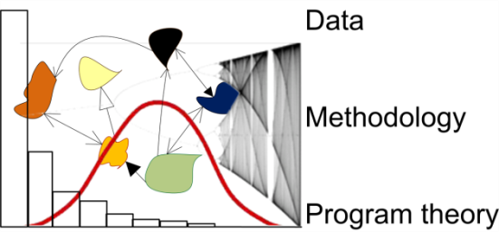
Final disclaimer and summary
I’m not trying to convert anyone into complexity devotees
Much of of evaluation we do works with traditional approaches
But we are often dissatisfied with our ability to do work improve the social condition
Even when programs don’t or can’t recognize complexity, evaluators can use complexity to make a difference

Slide 30
Some resources to show how I think about these things
Book
  Evaluation in the Face of Uncertainty: Anticipating Surprise and Responding to the Inevitable Jonathan A. Morell Guilford, 2010
Blog posts (https://evaluationuncertainty.com/)
Depicting Complexity in 2-D
Complexity is about stability and predictability
How to evaluate complex health interventions?
Matching management systems to system behavior
A rolling conversation about the “Agreement x Certainty” space
Drawing on Complexity to do Hands-on Evaluation Parts 1, 2, and 3
A Complex System Perspective on Program Scale-up and Replication
Things to think about when observing programs from a systems perspective
Timelines, Critical Incidents and Systems: A Nice Way to Understand Programs
Case Study Example for Workshop 18: Systems as Program Theory and as Methodology
Understanding sustainability – systems as a framework, thermodynamics as a metaphor
Power Law Versus Symmetrical Distributions — Implications for Policy Recommendations
What is the relationship between path dependence and system stability? With explanation of why I care.
Simple, Complicated, Complex and Chaotic VS. Complexity Science. Jonny finally resolved his confusion
Using an evolutionary biology view to connect the intellectual development of evaluation and the development of the evaluation community

